Slide 1
Nano – week 9
09/11 – 16/11
Klara, Yoran, Oscar

Slide 2
Objective
Project recap
Vsparticle
Analyzing nano particles
Threshold algorithm

Slide 3
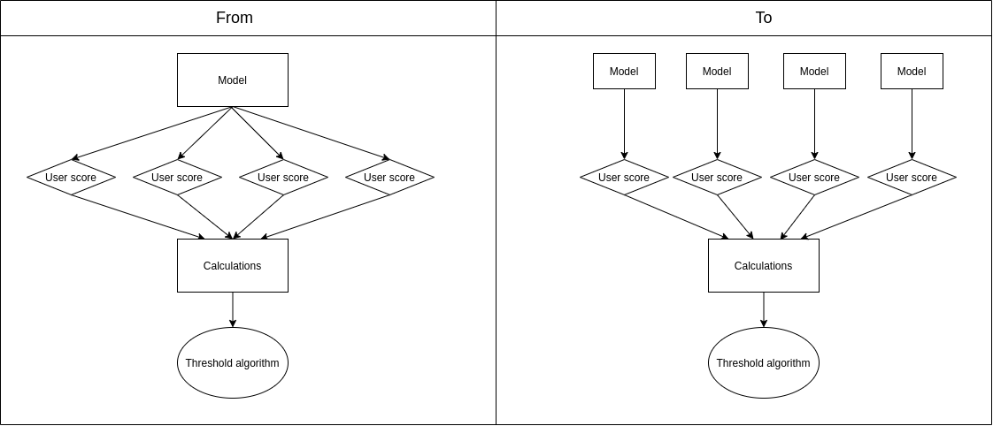
Changes from last week
Current approach
Drop out group member
Simplify approach
From one model to multiple
Imbalanced data
Optimize per threshold

Slide 4
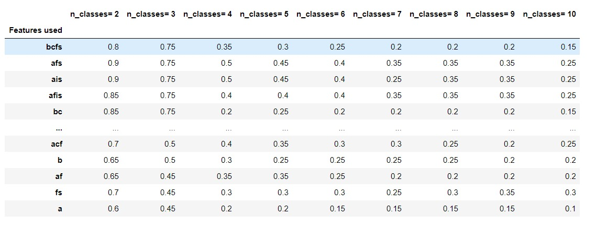
ML models
Results from last week
Neural Network: 3 layer fully connected network (YEN)
Different models
Machine learning
Deep learning
Different attributes
Different amount of classes

Slide 5
Coming week
Goals for this week
Continue testing different models/attributes/classes
Decide what model we want to continue with
Create proof of concept with YEN
Start with the final paper

Slide 6
Any questions or feedback?
Thank you!

